Slide 1

校園故事
HW03

Slide 2
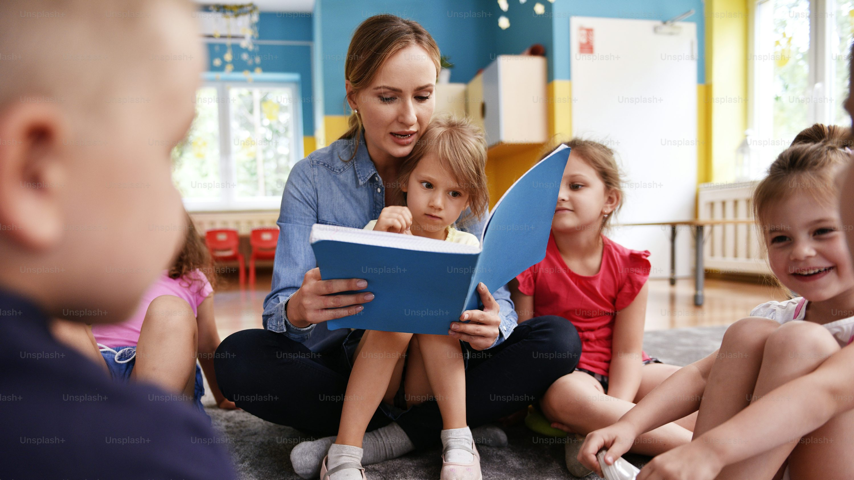
1.目標
Notes:
https://unsplash.com/photos/kids-and-teacher-reading-a-book-together-in-the-preschool-38DhmncNcRc

Slide 3
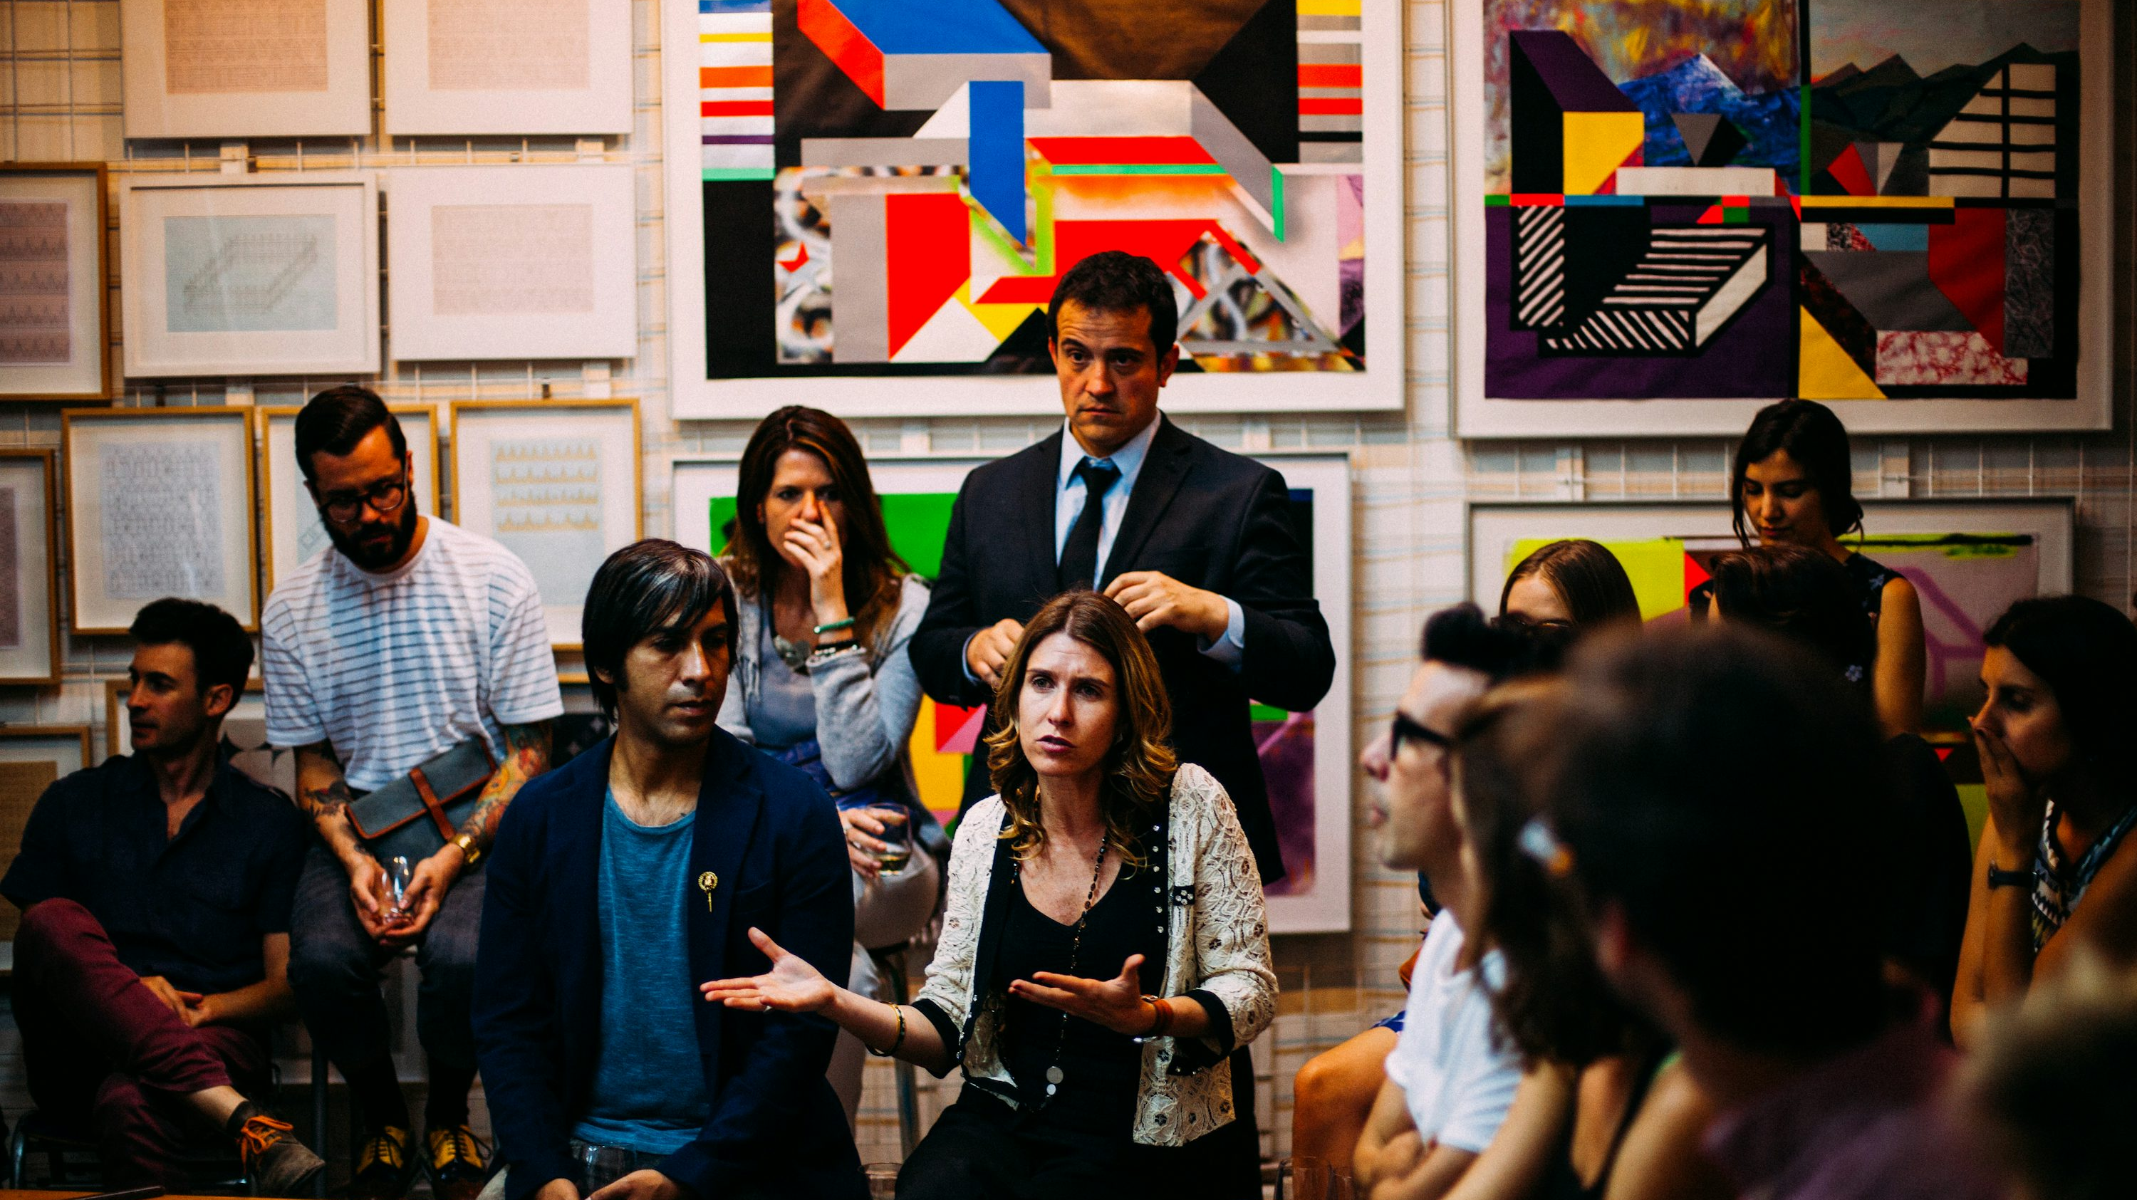
2.阻礙
Notes:
https://unsplash.com/photos/people-meeting-in-room-cw-cj_nFa14

Slide 4

3.努力
Notes:
https://unsplash.com/photos/person-turning-book-page-po7nbkEBEgM

Slide 5
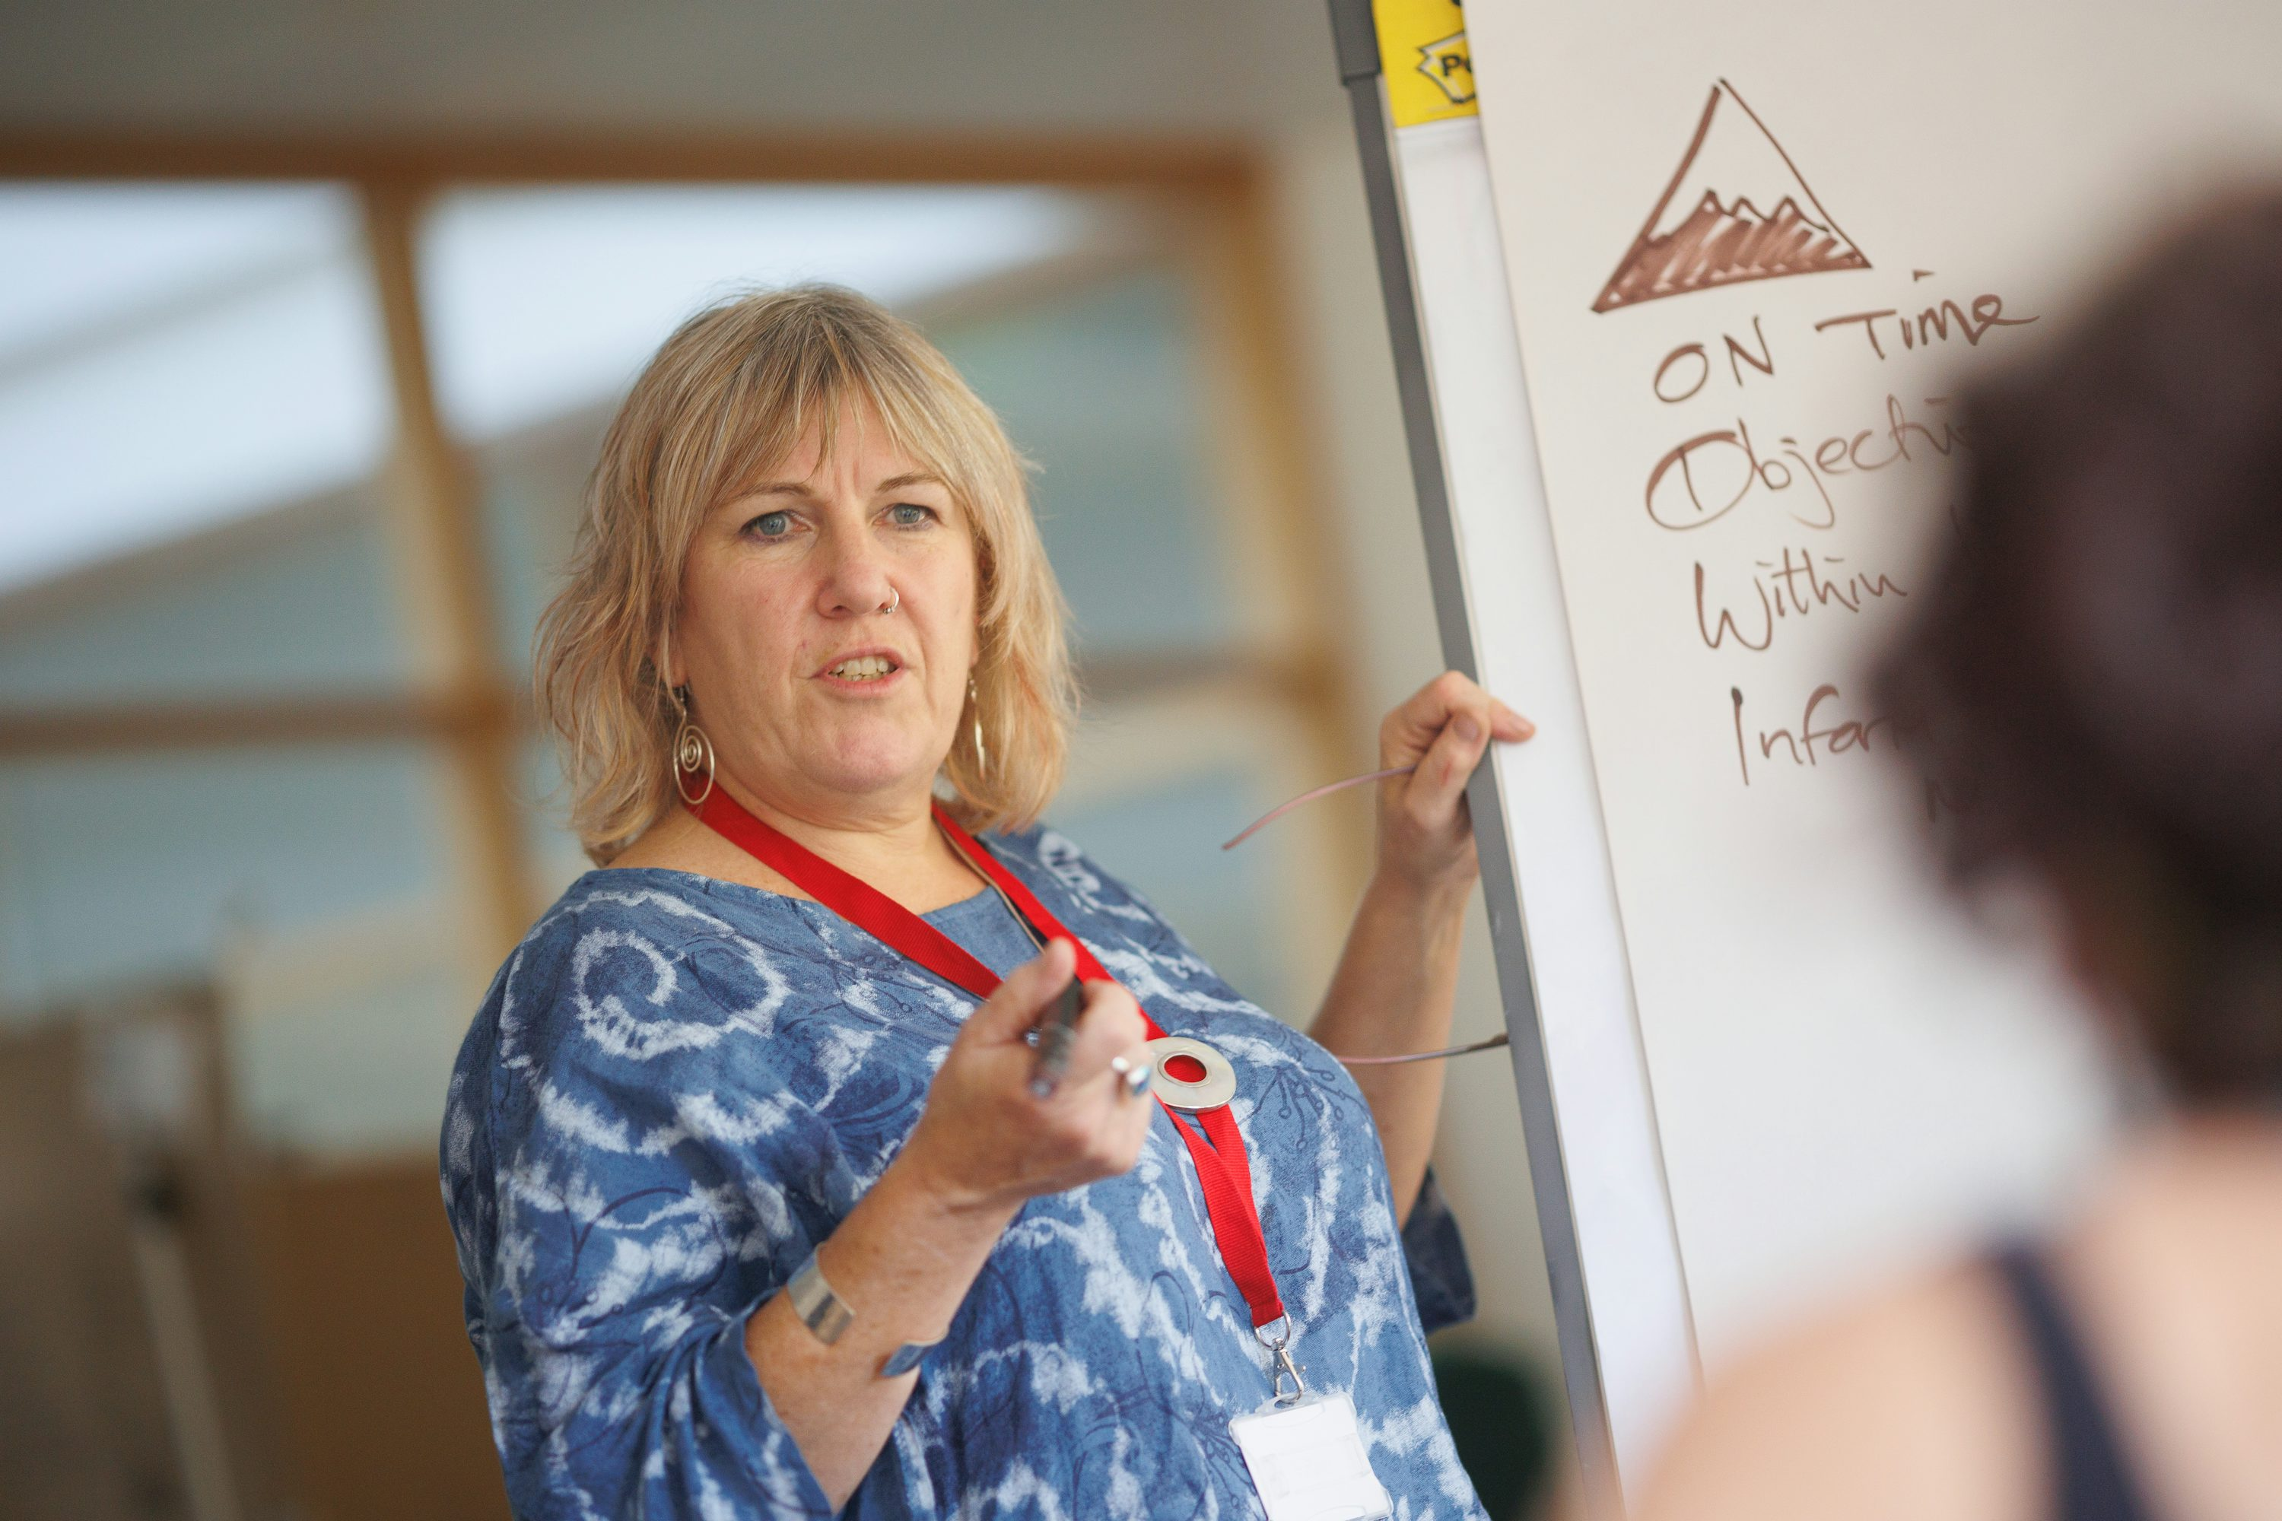
4.結果
Notes:
https://unsplash.com/photos/a-person-writing-on-a-whiteboard-cPyO3GEYjZ4

Slide 6
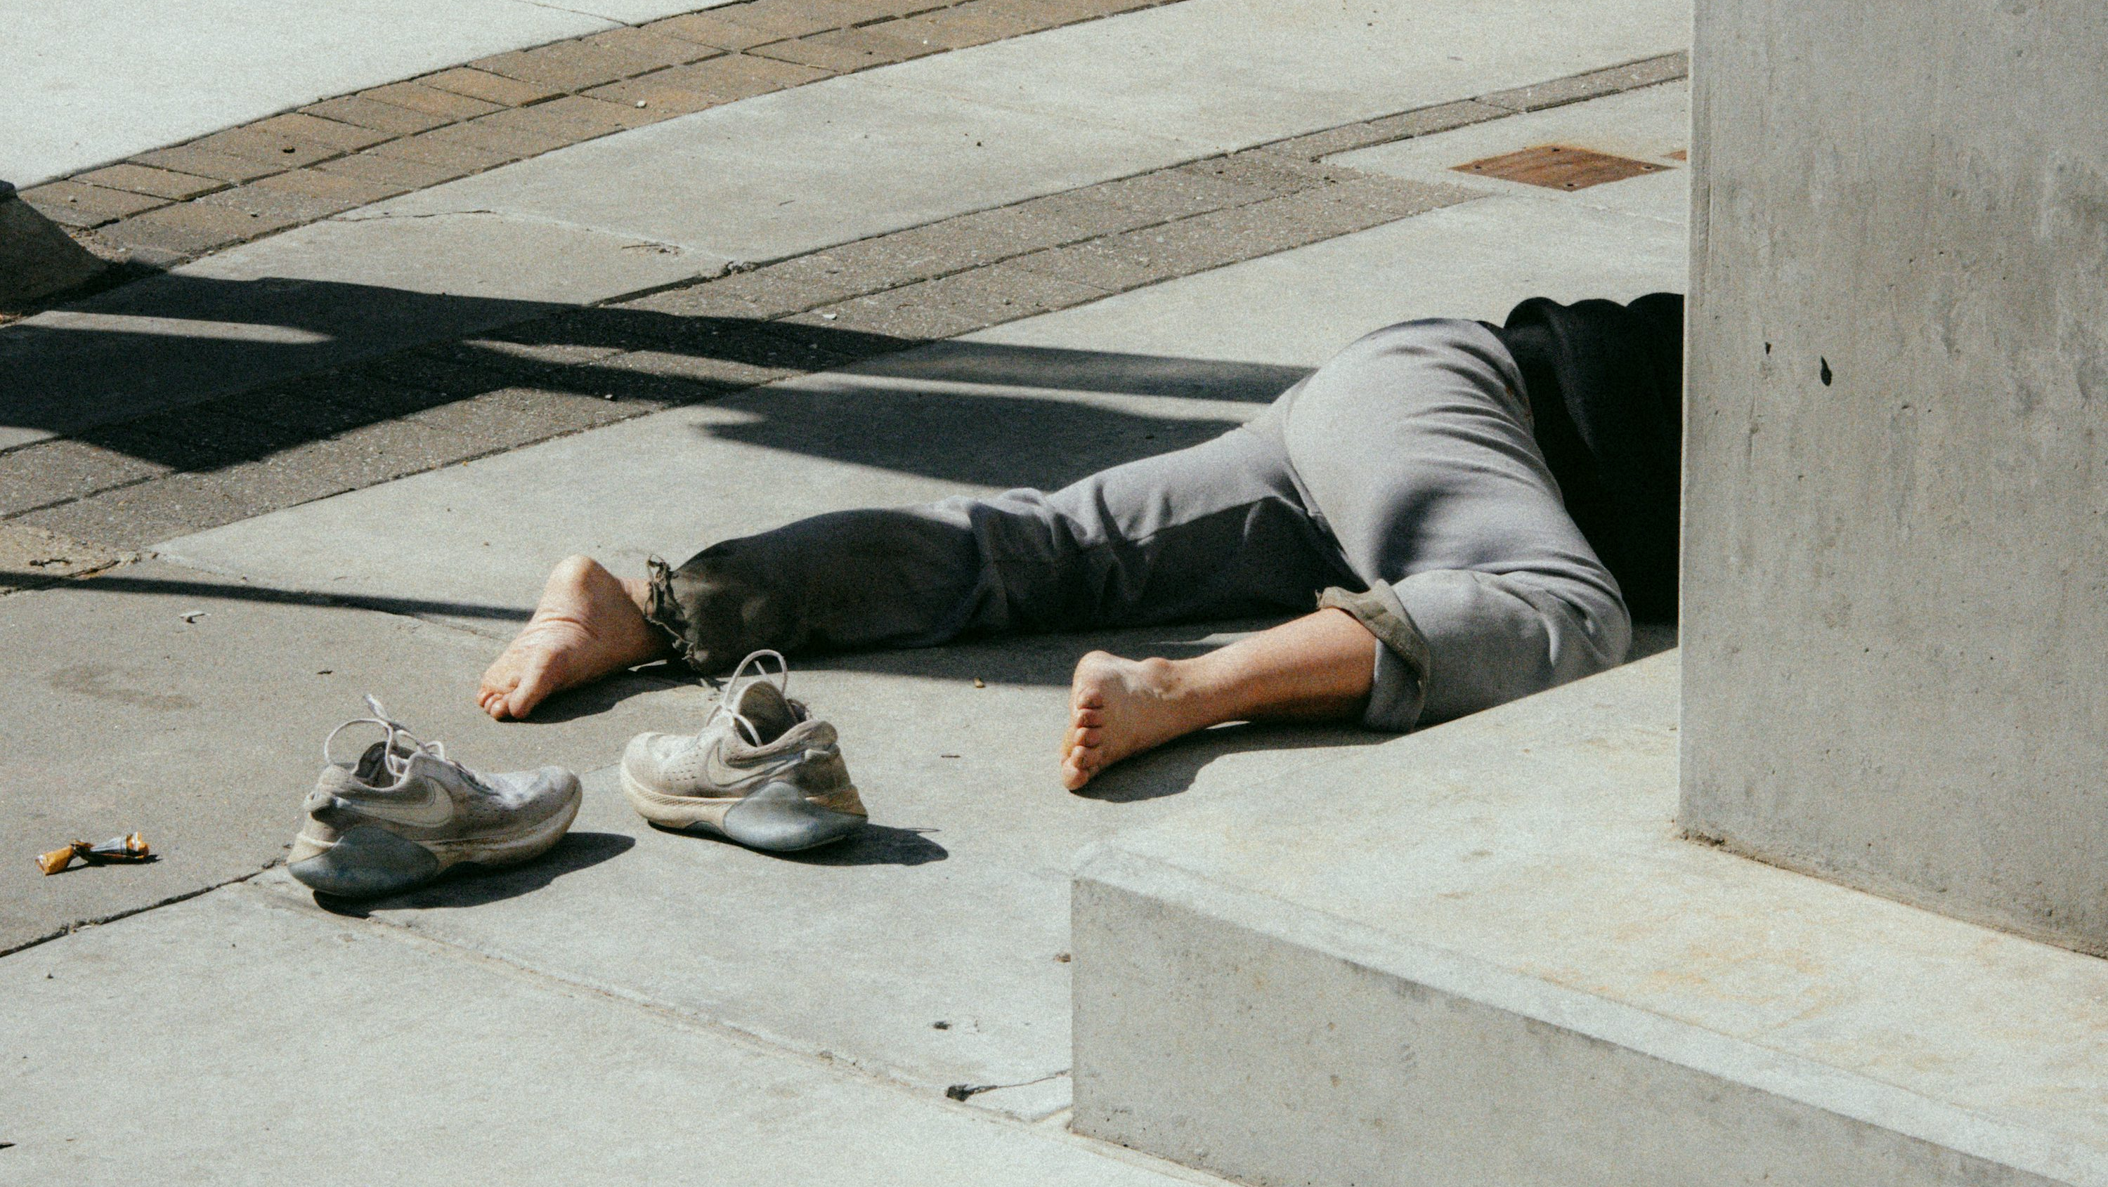
5.意外
Notes:
https://unsplash.com/photos/person-in-gray-pants-and-gray-shoes-sitting-on-concrete-bench-S9C4euiw5y4

Slide 7

6.轉彎
Notes:
https://unsplash.com/photos/woman-holding-sparklers-bokeh-photography-RhZ-Tl0QVqo

Slide 8
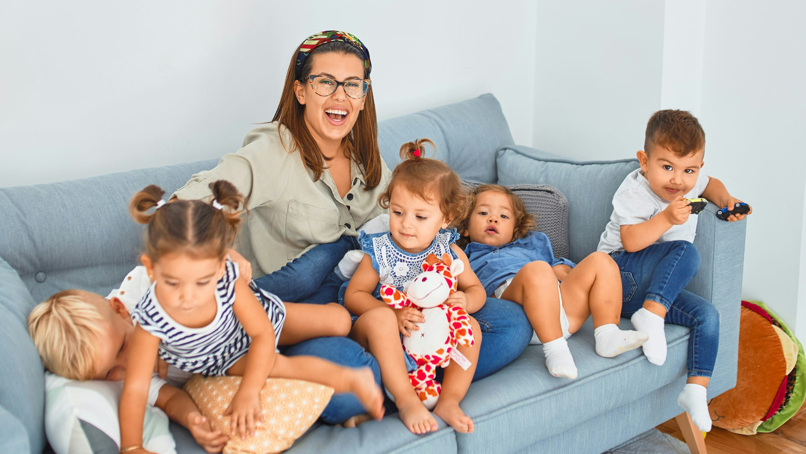
7.結局
Notes:
https://unsplash.com/photos/3-women-sitting-on-gray-couch-OroUwAwLs-8

